Slide 1

Field of Dentistry
Physiology for dental students I
Lecture : (Autonomic Nervous System 3 )
Dr : (Mohamed Talal)
Date : /10 /2026

Slide 2

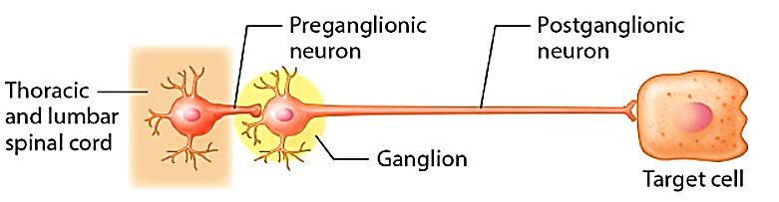
sympathetic nervous system :

Slide 3
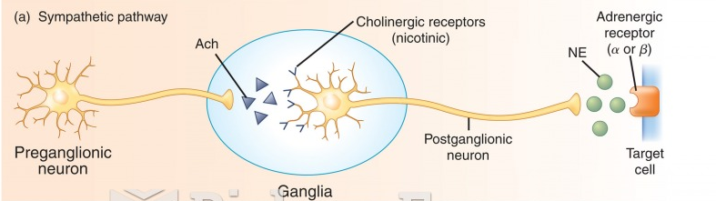
sympathetic nervous system:
(Biology – forums , copy rights )

Slide 4
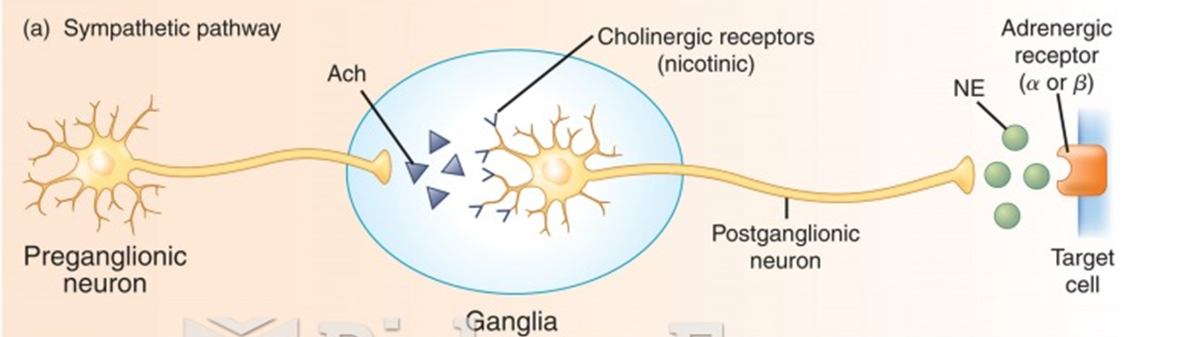
sympathetic nervous system:
Chemical neurotransmitter:
  Acetyl choline
  Noradrenaline
(Biology – forums , copy rights )

Slide 5
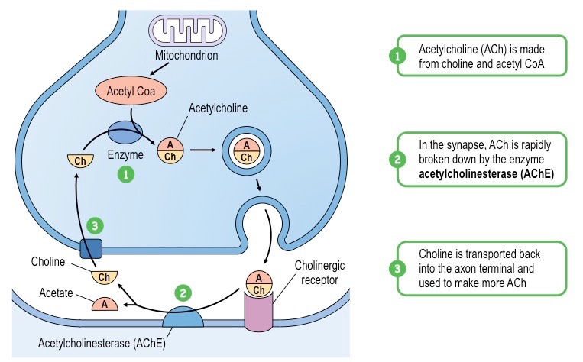
sympathetic nervous system:
Acetyl choline :
Formation:
Acetate + Co-enzyme A
Acetyl Co-A + choline
Acetyl choline

Slide 6
sympathetic nervous system:
Acetyl choline :
Removal:
By choline esterase enzyme

Slide 7
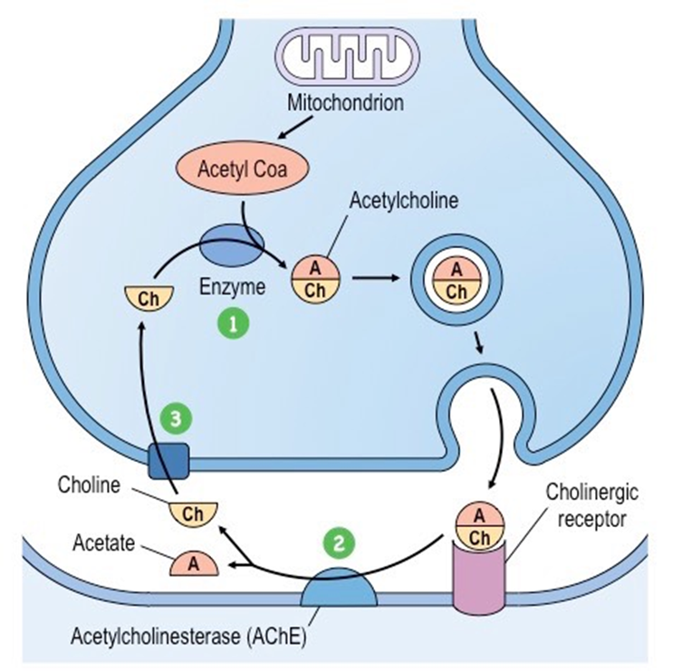
sympathetic nervous system:
Nicotinic receptors :
Site : Autonomic ganglia
Stimulated by : Nicotine small dose – anti-choline esterase
Blocked by : Nicotine large dose – hexamethonium – tetraethyl ammonium

Slide 8
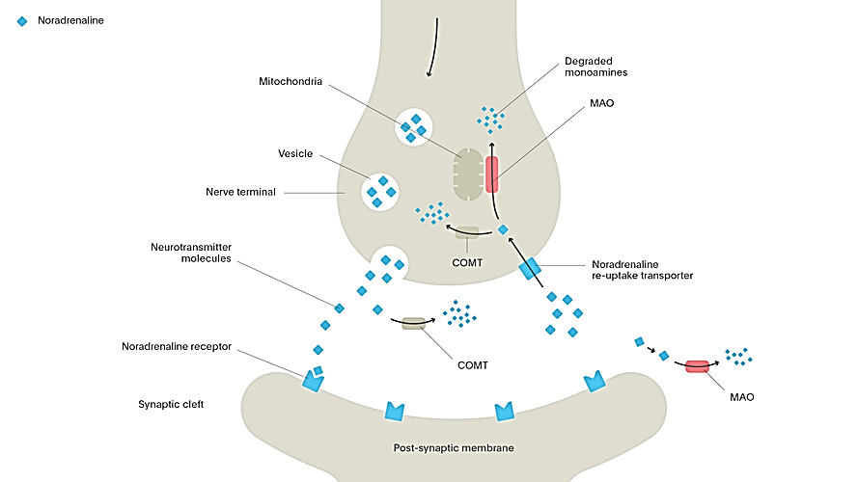
sympathetic nervous system:
Noradrenaline :
Tyrosine
L -Dopa
Dopamine
Noradrenaline

Slide 9
sympathetic nervous system:
Noradrenaline :
Removal: by
50 – 80% by active reuptake into nerve ending
destruction by :
MAO ( monoamine oxidase ) | COMT ( catechol-O- methyl transferase )

Slide 10
sympathetic nervous system:
Adrenergic receptors
α
α 1
α 2
β
β 1
β 2
β 3

Slide 11


